Slide 1




STATUS OF ANAEMIA AMONG ADOLESCENTS STUDYING IN RESIDENTIAL SCHOOLS OF ODISHA

Slide 2
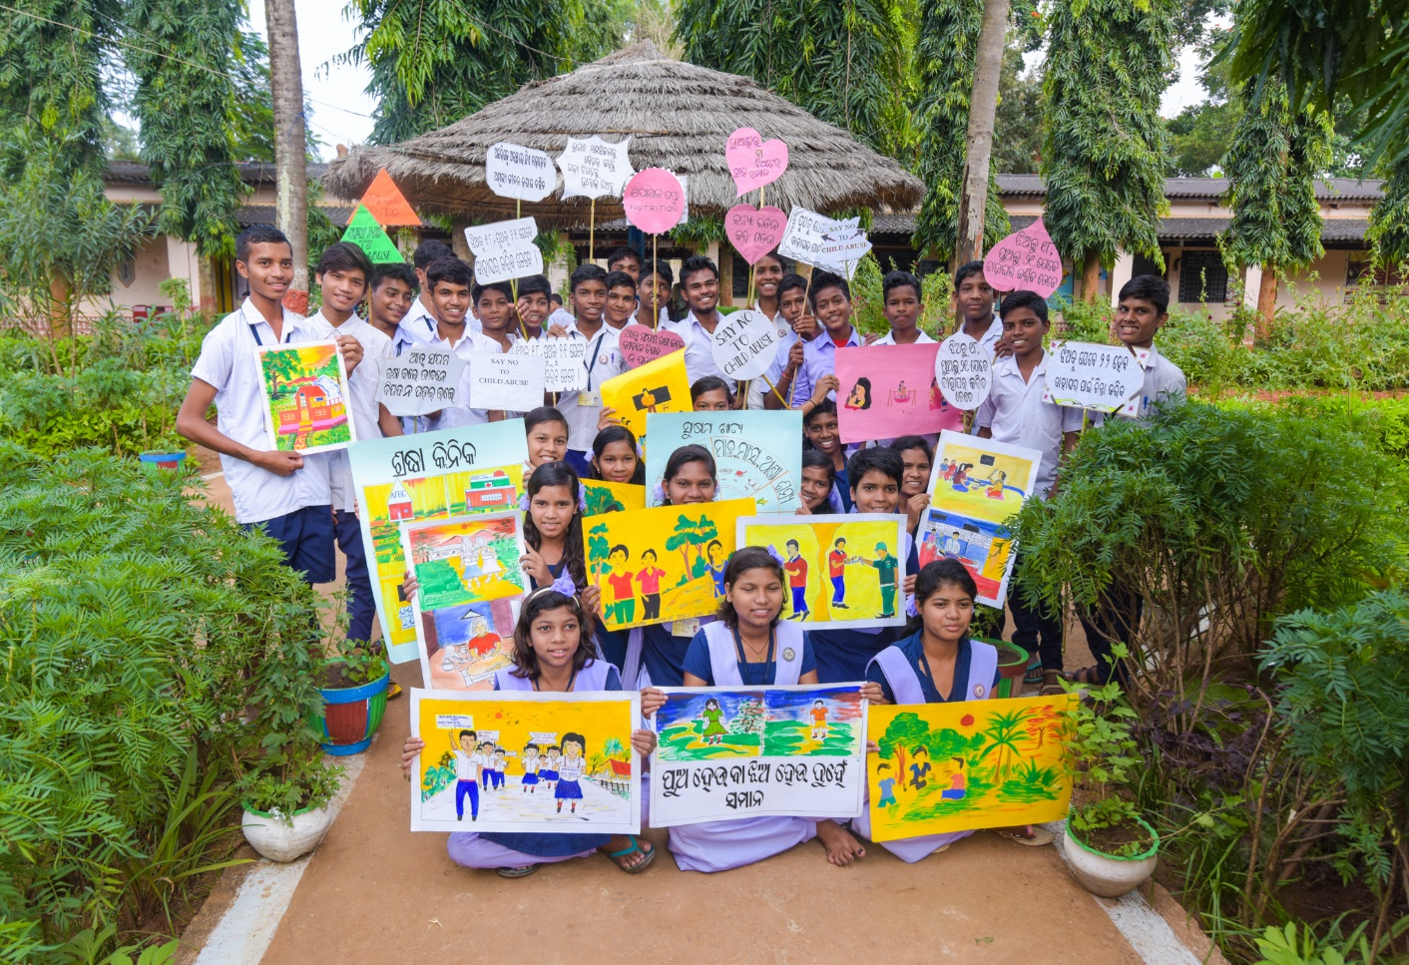
Introduction
Life Skills Education Programme (since 2012-13 expanded in phases)
Improving health, nutrition and wellbeing of adolescents in residential schools under ST SC department
UNFPA and APPI collaboration (since April 2018)
Objective
Enhance knowledge and skills among adolescents to adopt healthy behavior and to deal with life’s challenges in a positive and responsible way through the life skills education
Improve health & nutrition and ensure wellbeing of students in residential schools through inter-sectoral convergence and strengthening ongoing programmes

Slide 3
Life Skills Education: Components
Transaction of life skills sessions in classes by trained teachers - Fixed monthly calendar and time table in school – 24 session (20-22 Hours in a year)
Students trained as peer educators
Co-curricular activities – role play, quiz, comics, animations
Promote student friendly environment – sensitization on safety and security, SOPs facilitation in monitoring
Health screening, counselling and referral in convergence with health department in which addressing anaemia is one of the focus
S.No | Month | Themes
1 | July | Prevention of communicable diseases, Personal Hygiene and Nutrition
2 | August | Growing up and changes during adolescence including menstruation
3 | September | Early marriage, teenage pregnancy, conception and contraception
4 | October | RTI/STI and HIV/AIDS
5 | November | Safety, Security ad Sexual Abuse
6 | December | Myths and misconception around ARSH
7 | January | Substance Misuse and Peer Pressure
8 | February | Rights, Gender Sensitivity and Social Responsibility

Slide 4
Anaemia Screening : Key learnings from Pilot Phase (Aug – Dec’17)
Piloted in three districts - Gajapati, Rayagada and Kandhamal
Positive:
  Operational guidelines along with joint letter issued from NHM and SSD, development of microplan and skill labs for hands on training and practices
Challenges:
  Availability of Sub Centre ANM for hemoglobin testing
  Sahil’s method - Observational bias, Consumables
Only 25% (3705 out of 14,431) students screened for anaemia
RBSK team and SSD ANMs were engaged and oriented
Strip based haemoglobinmeter introduced

Slide 5
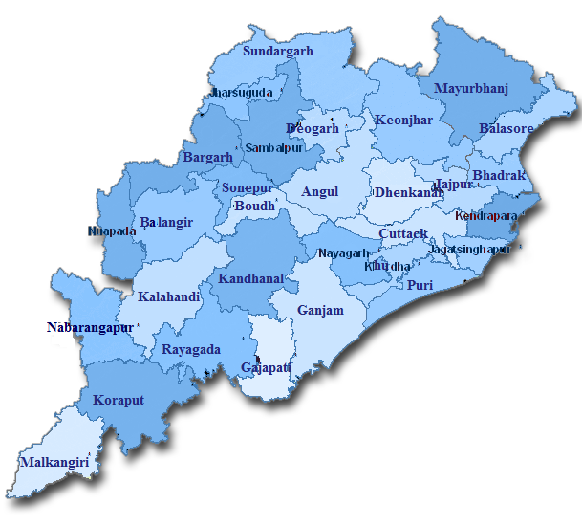
Phase I: Coverage of adolescents (Aug – Dec’18)
District | School | Boys | Girls | Total Number
Gajapati | 51 | 3,048 | 6,054 | 9,102
Kandhamal | 92 | 6,790 | 11,828 | 18,618
Keonjhar | 86 | 6,489 | 9,083 | 15,572
Koraput | 87 | 8,288 | 10,584 | 18,872
Rayagada | 79 | 11,314 | 12,558 | 23,872
TOTAL | 395 | 35,929 (41%) | 50,107 (59%) | 86,036
77,507 (90%) students were screened for anaemia
Students covered from standard 5th to 12th

Slide 6
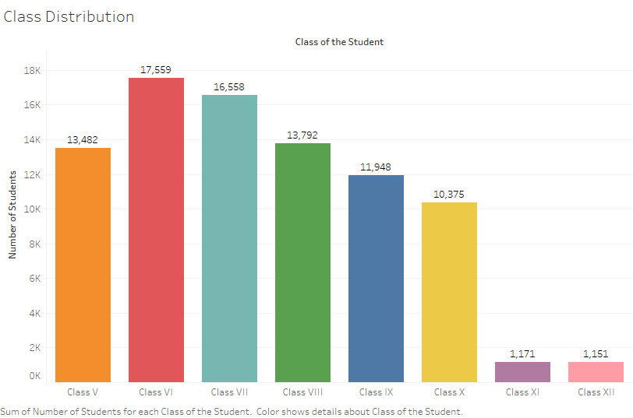
Class Wise Coverage of Adolescents
Total – 86,036

Slide 7
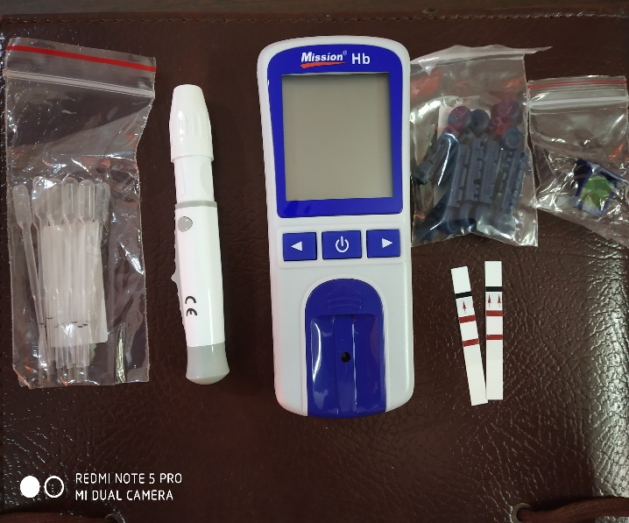
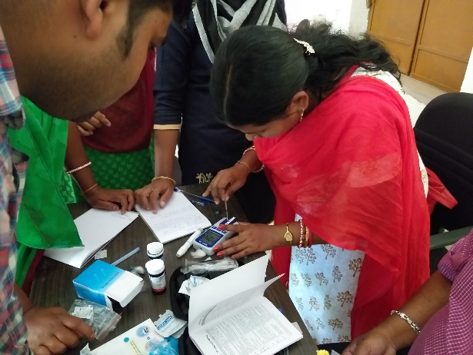
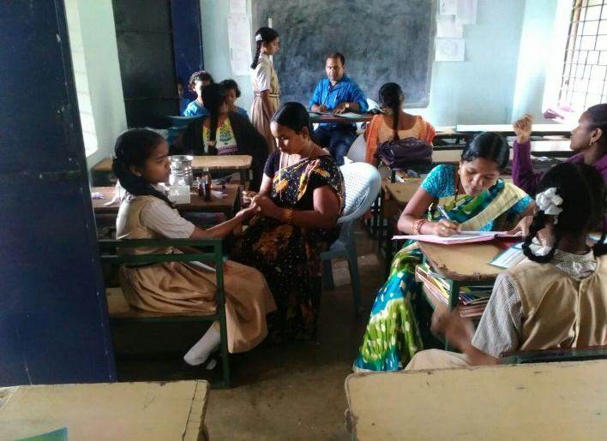
Steps undertaken (July to Dec’18)
Procurement of strip based Haemoglobinometer
Discussion with state and district NHM team
Revision / Development of Microplan
Orientation of RBSK and SSD ANM
Health Screening & monitoring
Data Collection, Analysis
April-July
June
Aug Sep
Aug Sep
Aug Dec
Oct Jan’19
Technical Specification - OSMCL
Letter issued from both departments
Joint planning exercise - RBSK team, DWO, WEO and ANM (SSD)
Hands on training on using Haemoglobinometer
DPOs provided handholding and monitoring support
Digitised database of 80,000 adolescents

Slide 8
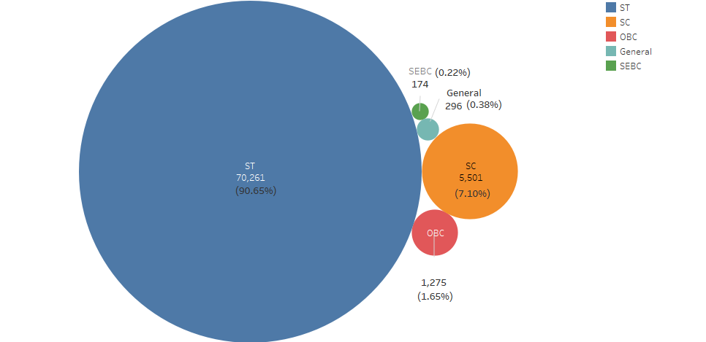
Findings: Social group wise coverage

Slide 9

Classification of anaemia among adolescent
<12 g/dl
11 – 11.9 g/dl
8 -10.9 g/dl
< 8 g/dl
Any anaemia
Mild
anaemia
Moderate
anaemia
Severe
anaemia
Women | <12 g/dl | 10.0 -11.9 g/dl | 7.0 – 9.9 g/dl | <7 g/dl
Men | <13 g/dl | 12.0 – 12.9 g/dl | 9.0 -11.9g/dl | <9 g/dl
NFHS - 4
Source: Guidelines for Control of Anaemia, National Iron Plus Initiative, MOHFW, GoI

Slide 10
Prevalence of Anaemia
N= 77,507
5 Districts
N= 3,705
3 Districts
50%
32%
56%
22.5%
24%
1.5%
10%
3.4%
77.4% students were found to be anaemic
(August to December 2018)
90% students were found to be anaemic
(Pilot phase: August to December 2017)

Slide 11
Gender Wise Prevalence of Anaemia
68%
83%
55%
42%
32%
24%
4.2%
2%
24%
16%

Slide 12
Odisha - Survey data
Date Source | Any Anaemia (%) |  | Mild Anaemia |  | Moderate Anaemia |  | Severe Anaemia
 | Male | Female | Male | Female | Male | Female | Male | Female
NFHS 4 (15-19 years) | 30.3 | 51 | 16.4 | 40.6 | 13.3 | 9.6 | 0.6 | 0.8
Health Screening (10-19 years) | 67 | 81.2 | 24 | 24 | 42 | 55 | 2 | 4.2
AHS 2014 (10-17 years) | 70.5 | 78.4 | -- | -- | -- | -- | 2.4 | 3.1
NFHS 4 (ST) (15-49 years) | 40.1 | 63.3 | 18.6 | 46.9 | 20.2 | 15.3 | 1.3 | 1.2

Slide 13
Prevalence of anaemia across age group and gender
72.2
83.5
42.5
82.1
37.1
83.5
As age increases, anaemia decreases in male while it remains stagnant in female.

Slide 14
District Wise Distribution
Koraput (4.98%) has the highest prevalence of severe anaemia cases
Gajapati (85.42%) has the highest prevalence of anaemia (any) cases

Slide 15
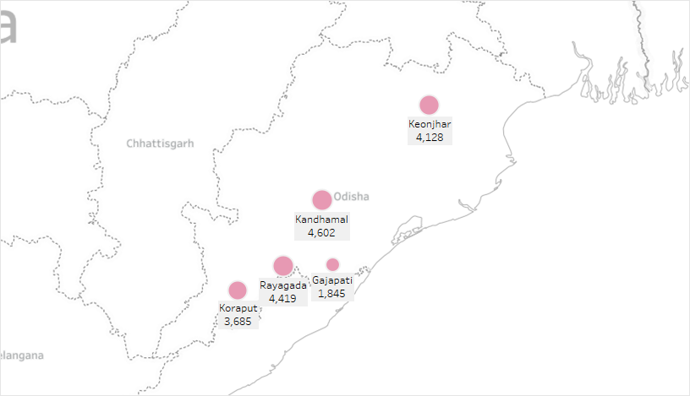
Number of Mild Anaemia Cases across Districts

Slide 16
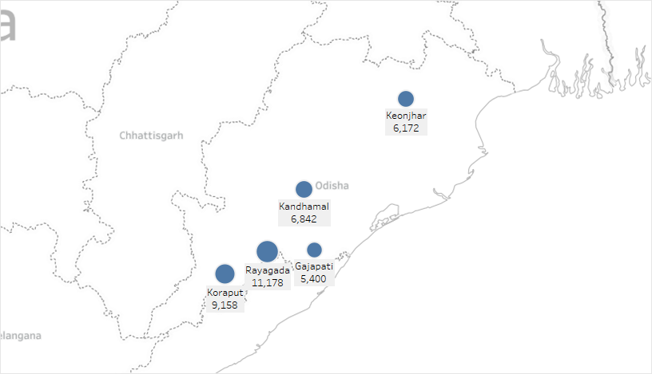
Number of Moderate Anaemia Cases across Districts

Slide 17
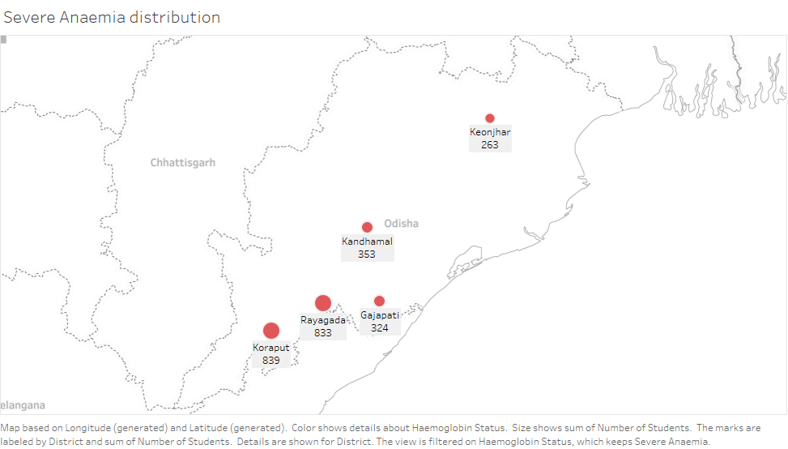
Number of Severe Anaemia Cases across Districts

Slide 18
Suggested Interventions as per Anemia Mukt Bharat guideline
Testing of anaemia using digital method and point of care treatment
Prophylactic iron and folic acid supplementation
Deworming
Behaviour change communication
Address non-nutritional cause of anaemia in endemic pockets (malaria, hemoglobinopathies, flurosis)
Provision of IFA fortified foods

Slide 19
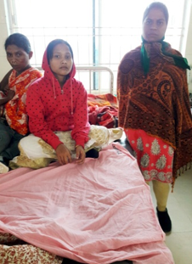
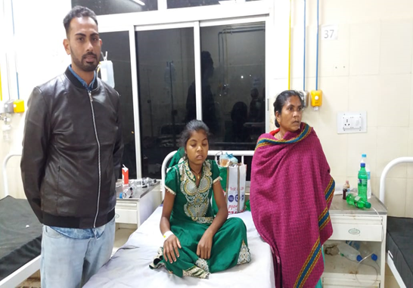
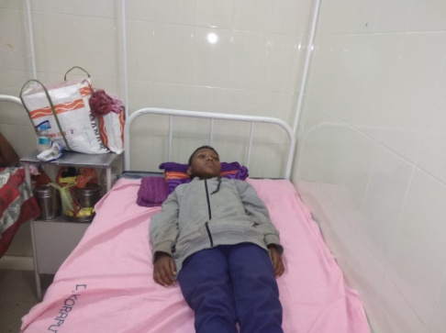
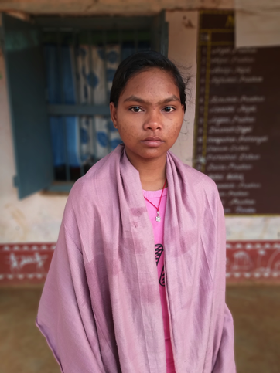
Case Studies - Severe Anaemia Cases
Age-15; Class-10th
School- GG High School
Hb - 5.2 g/dl
Referred to - District HQ, Jeypore, Koraput
Action- Blood transfusion
Sickle Cell status-Negative
Age-13; Class-8th
School-Pottangi Girls High School
Hb status-5.4 g/dl
Referred to-CHC, Pottangi, Koraput
Action taken- Blood transfusion
Sickle cell status-Negative
Age-13; Class-7th
School-Umuri AS
Hb status-6 g/dl
Referred to-DH Koraput
Action taken- Blood transfusion
Sickle cell status-Negative
Note-Blood donated by Asst. Teacher
Age-15; Class-10th
School-Raikia Girls High School
Hb status-5.2 g/dl
Referred to-PHC,Phulbani, Kandhamal
Action taken- Blood Transfusion
Sickle cell status-Negative

Slide 20
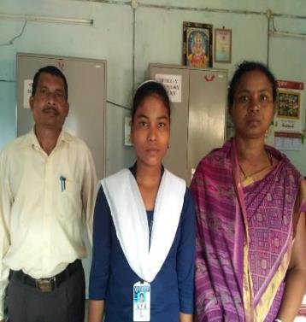
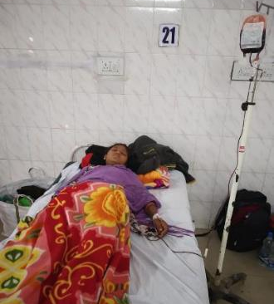
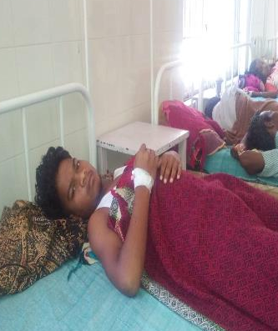
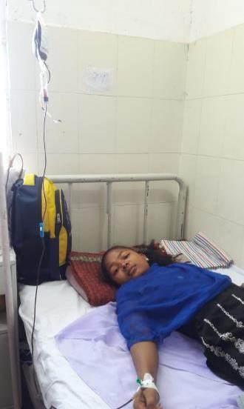
Case Studies - Severe Anaemia Cases
Age-15; Class-10th
School-Haradaput Girls High School
Hb status-5.3 g/dl
Referred to-HQ hospital Jeypore, Koraput
Action taken- Transfused blood
Sickle cell status-Negative
Note- DPO facilitated for free blood transfusion
Age-13; Class-7th
School-K.C Pur GH School
Hb status-6.1 g/dl
Referred to-DHH, Gajapati
Action taken- Blood Transfusion
Sickle cell status-Positive
Note- Blood donated by DPO,LSE + Programme
Age-15; Class-10th
School-Chandragiri GHS
Hb status-5.2 g/dl
Referred to-DHH, Gajapati
Action taken- Blood Transfusion
Sickle cell status-Negative
Note- Blood donated by Asst. Teacher, Chandragiri GHS
Age-13; Class-7th
School-Gupteswar High School, Baipariguda
Hb status-4.6 g/dl
Referred to-DHQ Jeypore
Action taken- Blood Transfusion
Sickle cell status-Negative
Note- Blood donated by Asst. Teacher

Slide 21
Guideline for Management of Anaemia Cases
Source: Guidelines for Control of Anaemia, National Iron Plus Initiative, MOHFW, GoI

Slide 22
Points for discussion
Treatment of severe anaemia cases on priority
Orientation of district team for treatment and follow-up for moderate and mild cases
Supply of IFA tablet in schools
Regular review and follow up - district level and at state level
Nodal person at state and district level

Slide 23
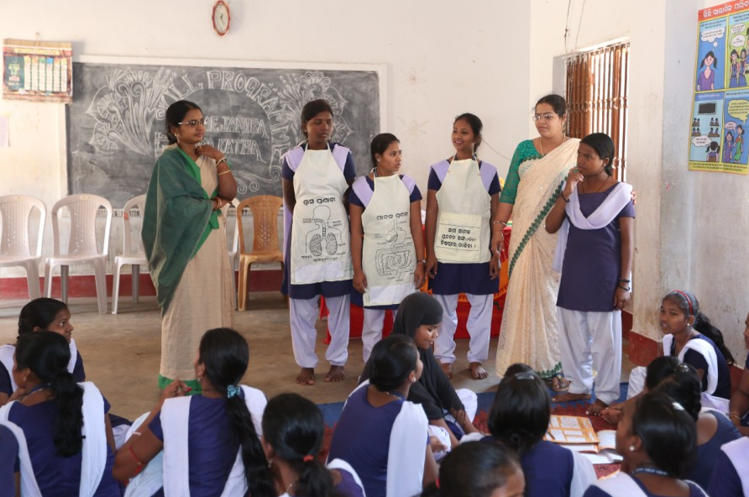
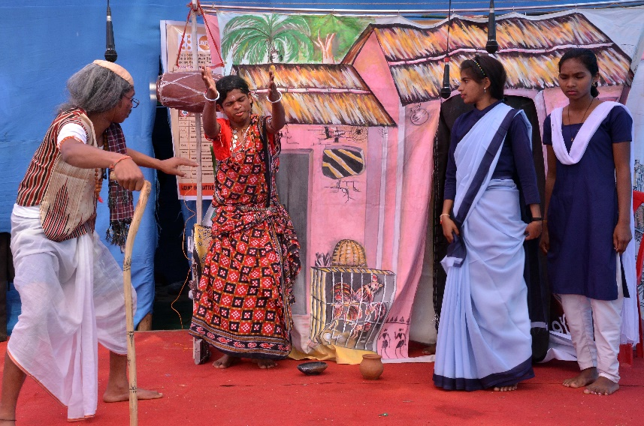
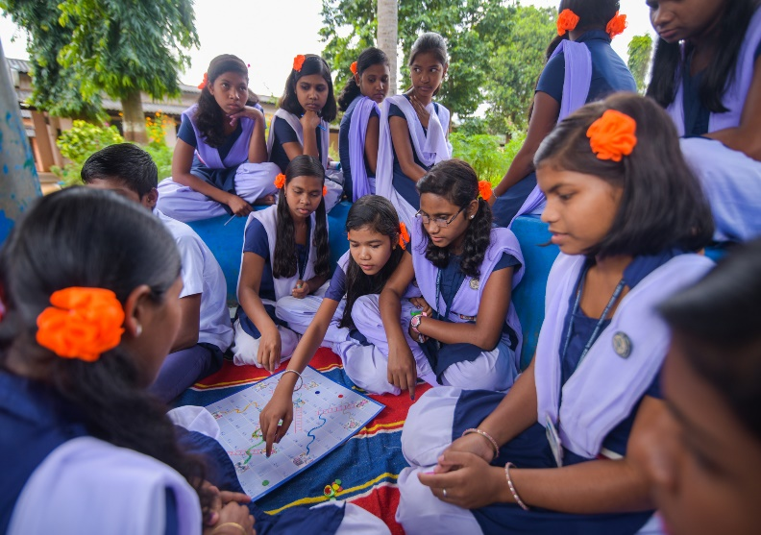
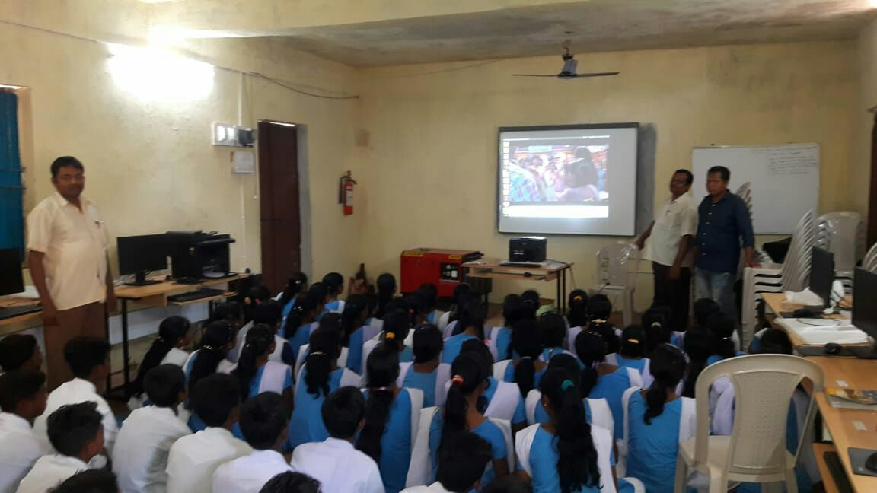
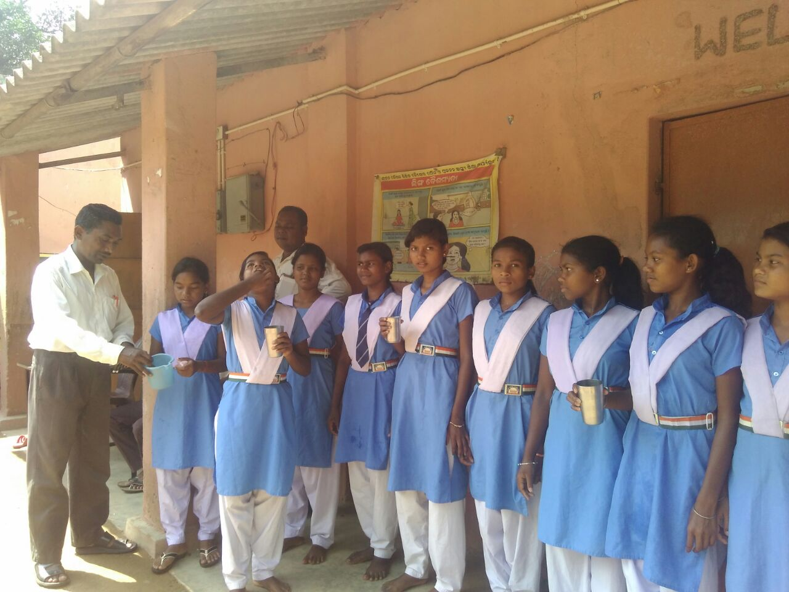
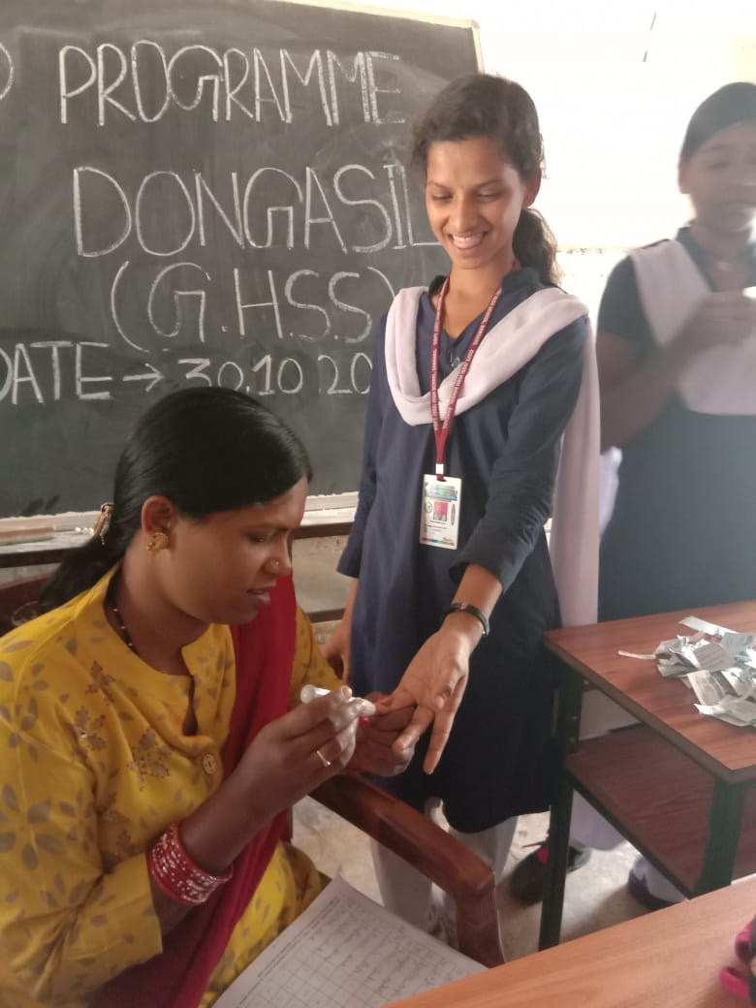
Glimpse of activities
Life skills (LSE) transaction in class
It’s about fun and enjoyment
Learn while you play
Thematic animations and videos introduced
WIFS being observed in school
Haemoglobin testing ofstudnets

Slide 24
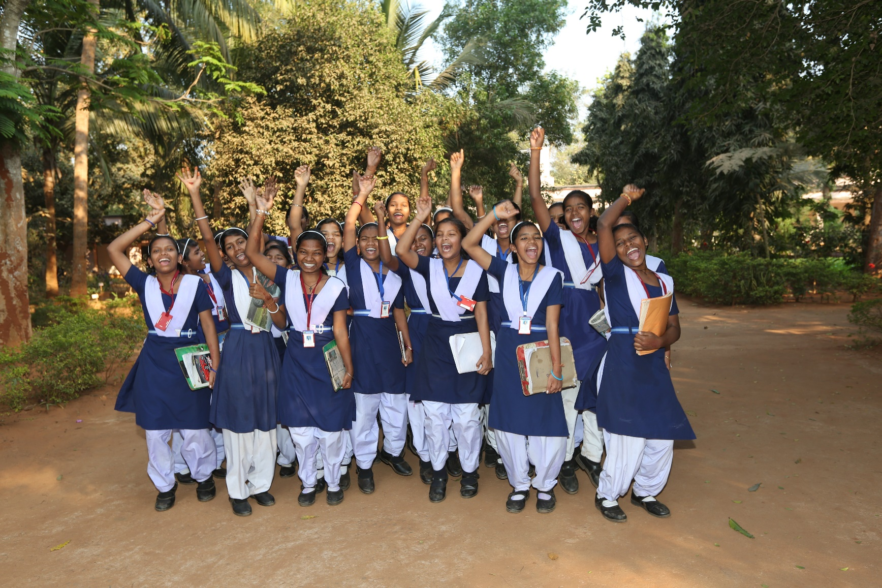
Thanks

