Slide 1


Life Skills Education Programme for Underprivileged and Vulnerable Adolescent in Tribal Residential Schools
A Joint Initiatives of SCSTRTI, SC & ST Development Dept. Govt. of Odisha and United Nation Population Fund (UNFPA)

Slide 2
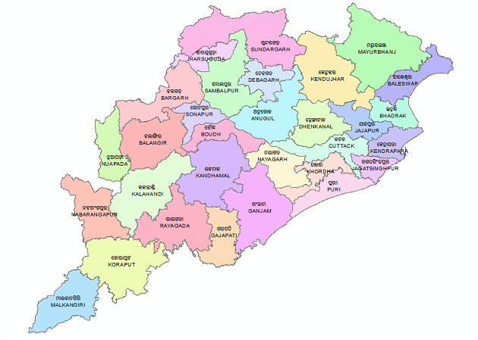
Project Background
State Demography Highlights
Indicators | Total | SC | ST
Population (in Million) | 41.97 | 7.19 (17.13%) | 9.59 (22.85%)
Literacy Rate | 72.87 | 69.02 | 52.24
Sex ratio | 979 | 987 | 1029
Adolescent (10-19 yrs) | 22% | - | -
Youth population (15-35 yrs) | 36% | - | -
Census - 2011
Tribal Sub Plan (TSP)
- | Total | TSP (Tribal Sub-Plan)
District | 30 | 22
Block | 314 | 119

Slide 3
Challenges of Tribal Youth and Adolescent in the State
Poor reproductive and sexual health which is associated with many myths and misconceptions
School dropout to support family income and early marriage
Gender based discrimination
Substance misuse and Peer Pressure
Chances for association with left wing extremist group

Slide 4
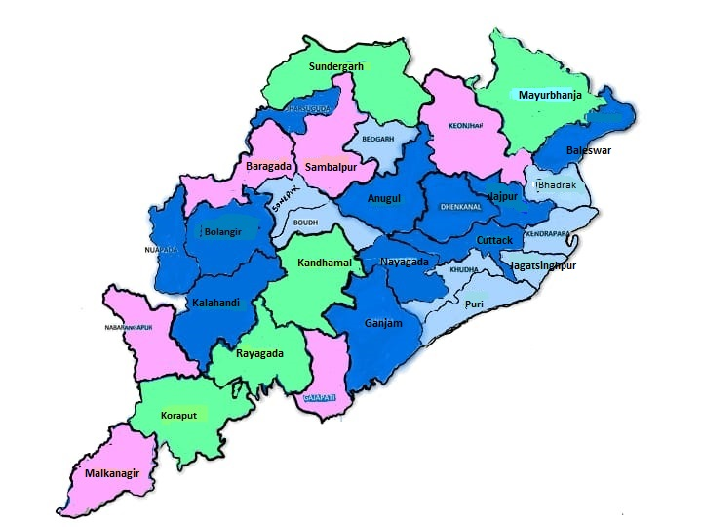
Tribal Residential School
Coverage:
Total School:1733
Sevashram (1st to 5th): 506
Ashram School(1st to 8th): 705
High school (8th to 10th): 422
Educational complex (1 to 8th): 19
EMRS (6th to 12th): 19
Higher Secondary (11th-12th): 62
Total Students: more than 5.75 lakh
Boys:41%
Girls:59%
Number of School
0-20
21-50
51-100
>100

Slide 5







LSE Programme – Approaches and Focus
Teachers transact weekly life skills sessions on fixed days as part of school timetable
Female Health Workers (ANM) conduct health education, screening, counselling and referral
Matrons undertake counselling sessions beyond school hours and ensure adherence to safety protocols and covecomming challenges of teean age pregnency and early marriage
Peer Educators provide age appropriate growing up information and influence building positive behaviour
Co-curricular activities promoted to create awareness on rights of young people and reinforce life skills based SRH messages.
Tool Free (18003453040) and Hotline phone in hostels for reporting emergencies and untoward incidents in school to the state control room.
Aneamia Screening and Treatment

Slide 6
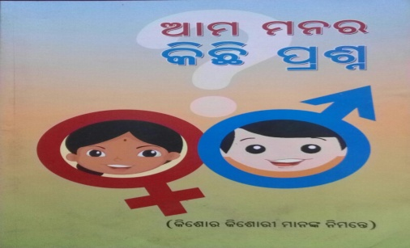
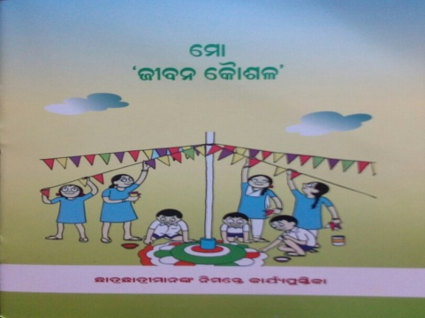
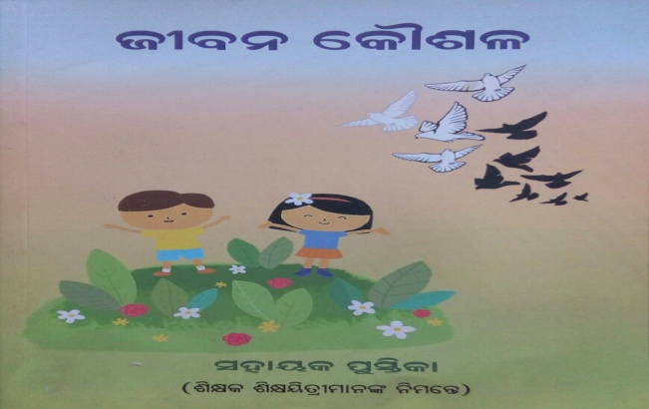
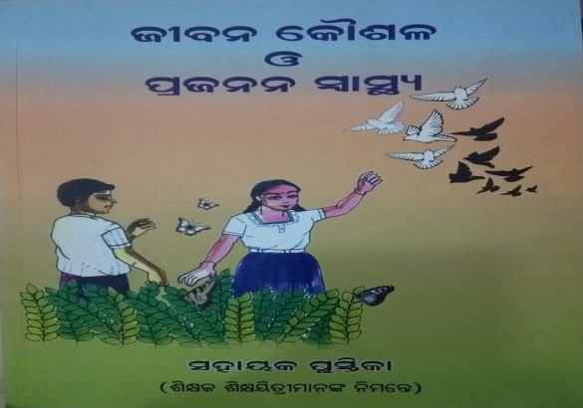
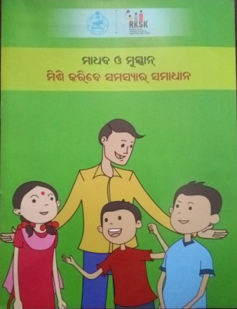
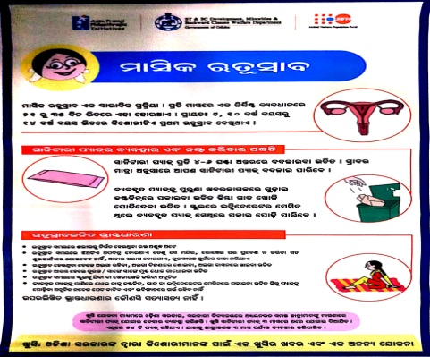
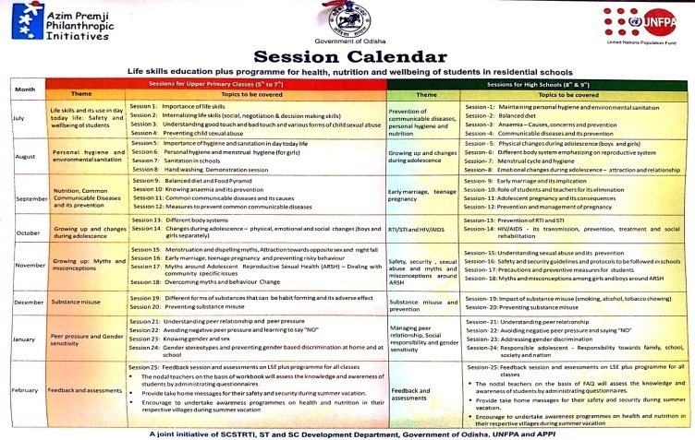
Resources & Communication Tools on LSE
Resource tools for Student
Resource tools for Teacher
FAQs
Work Book
Upper Primary teachers manual
Secondary Teachers manual
Comics
Posters

Slide 7
Issues Addressed under LSE Programme
Promoting personal and menstrual hygiene
Awareness on RTI.STI & HIV/AIDs
Overcoming challenges of Early marriage and teenage pregnancy
Anaemia control and communicable diseases
Substance misuse and peer pressure
Overcoming myths and misconception associated with growing up process and gender based discrimination
Growing up process - Sexual and reproductive health and rights
Promote girl child education and stop school drop out

Slide 8
Highlight of LSE programme – 2015-2018
Life Skills Education introduced for 8th and 9th Grade students and further expended to schools for covering 7th grade Students
Training and capacity building of around 2000 teachers, 260 ANMs, 2000 matrons, 300 supervisory cadre officials and 4000 key functionaries responsible for management of residential Schools
Fixed weekly period on LSE by trained teachers
Creative communication activates for promoting life skills
Supported department to frame guideline for safety of students and zero tolerance for sexual abuse of Student
Engagement with SMC and PTA for addressing the issues relating to girl child education, Child marriage and Teen age pregnancy
Supported for strengthening school monitoring by instituting a monitoring checklist for supervisory officers
Facilitated for establishment of Control room and Tool free/Hotline phone for reporting sexual abuse and untoward incidence

Slide 9
Highlights of Outcome of LSE Programme (2015-2018)
Life Skills Education become a core activity at Schools and Hostels
Zero tolerance policy for sexual abuse of students in Schools and implemented SOP on safety protocols
State level control room/School monitoring cell and Hot line/ Toll free number for reporting of sexual abuse

Slide 10
Partnership With APPI
Objective of the Intervention:
Establishing interdepartmental convergence for Anaemia screening and control
Promoting age appropriate Life skills Education for enabling platform in residential schools
Strengthen Monitoring System and introduction of IT enabled platform for schools monitoring

Slide 11
Programme Coverage
Project Duration (April-2018 to March-2021)
Coverage Area: 5 Districts
Keonjher
Kandhamal
Koraput
Gajapati
Rayagada
Coverage school: 395 Nos.
Middle Schools (Ashram School): 224
Secondary Schools : 171
Coverage Students (class 5th onwards): 92309
Boys:38058 (41%)
Girls: 54251 (59%)

Slide 12
Key Components and Milestones
IT based Tools for Program Monitoring and reporting
Introduced Audio/Video tools and self learning IEC tools on LSE
Convergence for strengthening WIFS/Khusi sanitary napkin
Anaemia Screening and treatment

Slide 13
Highlight of APPI intervention
Focused life skills education and anaemia control programme piloted in 395 residential schools in identified five Tribal Sub-Plan districts
Self learning IEC tools along with Audio-Video tools on life skills based SRH education and covering students from 5th grade onwards
Convergence for anaemia screening and aneamia control activities
Baseline - Anaemia screening conducted during December 2018 for 77507 students, reported 77.47% anemic students
Coordination for IFA prophylaxis dose for mild and moderate students and referral treatment for severe anaemic students at FRUs
The retesting of anaemia for around 72938 students in 2020 shows there is over all anemia students are 52.79%
Reduction of around 24 points of anaemic students in schools
Facilitated for identification of key indicators and development of IT enabled mobile applications for school monitoring and its rolling out in four districts
Introduction of LSE under ALMP and tele-counselling during COVID
Notes:
supported

Slide 14
Findings of Anaemia Control Initiative (2018 &2020)
Key Findings:
Almost 109% (24 points) increase (17,067 to 34433) registered in number of students with no anaemia
Very minimal changes in Mild anaemia (6.59%)
Almost 48% (24 points) decline in moderate anaemia (19,737)
Severe anaemia has reduced by 69% (2 points) (1,855)
In 2018 – 77,507 students were screened for anaemia (Total Students – 86,036)
In 2020 – 72,938 students were screened for anaemia (Total Students – 77,329)
39,423 students were retested and whose data was available from 2018 as well as 2020 survey

Slide 15
IT based Tools for Strengthening School Monitoring
IT tools for LSE+ Programme
IT tools for SSD Dept.
School monitoring Apps – User DPO
School reporting Apps(LSE) – User LSE trained Teachers/HMs
Anaemia Screening eporting Apps – User ANMs
School visit reporting Apps – User ANMs
Daily School reporting Apps – HMs
School visit reporting Apps – User Supervising Officers

Slide 16
Support to other Department for Life Skills Education
WCD
Master trainer training program for ADVIKA programme
Sports dept.
Training of sports personnel in 18 hostels
OPEPA
* Life skills and counselling training module Development
* Training of State and District master trainers
* LSE in 19000 middle schools covering around 2 million students
182 KGBV
Training of wardens and LSE tools
OAV
(Odisha Adarsha Vidyalaya)
Master trainer training
Orientation of Teachers
Life skills tools for 150 OAVs

Slide 17
Support for COVID Management and Online Platform for Life Skills Education
Translation of Covid guideline and massages in 5 tribal dialects
Working closely with OSDMA for training of Volunteers on Covid safety and Management
Trained 2500 Volunteers from NSS, NYKS and Scout and Guide
Established online mechanism for LSE through ALMP
Supported the department for introduction of telephonic counselling to students and put up standard guideline
Trained 4200 teachers, 11000 SMC/PTA members, 254 ANMs,1600 Head masters and 2400 Matrons through online platform on life skills
Weekly LIVE LSE sessions through trained teachers

Slide 18
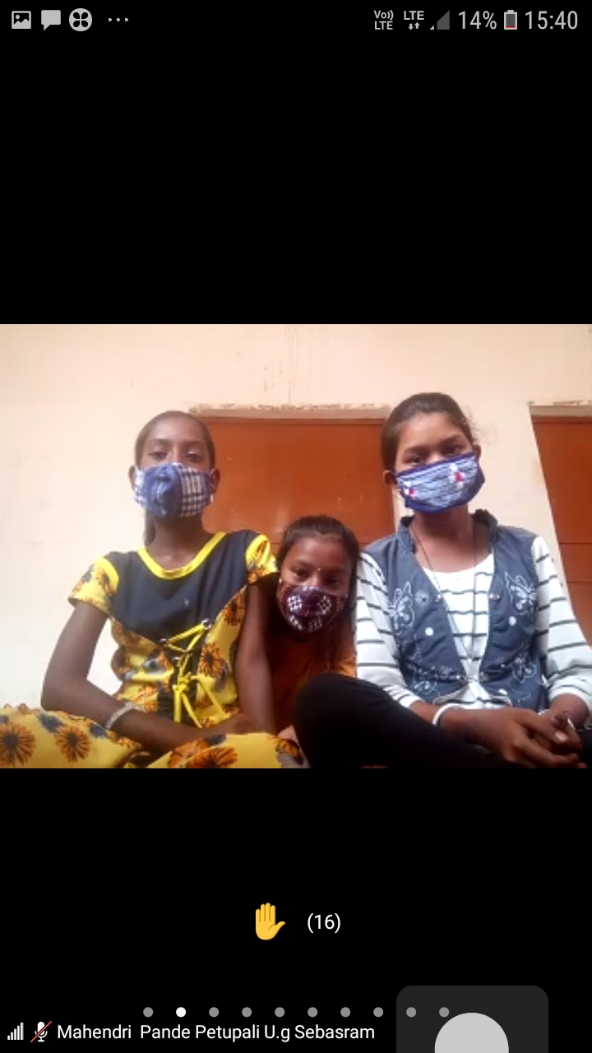
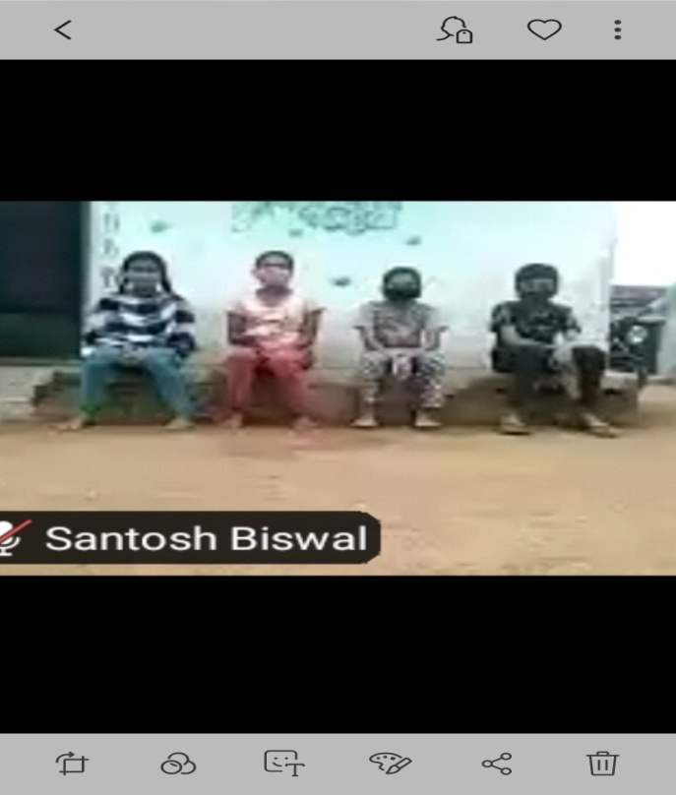
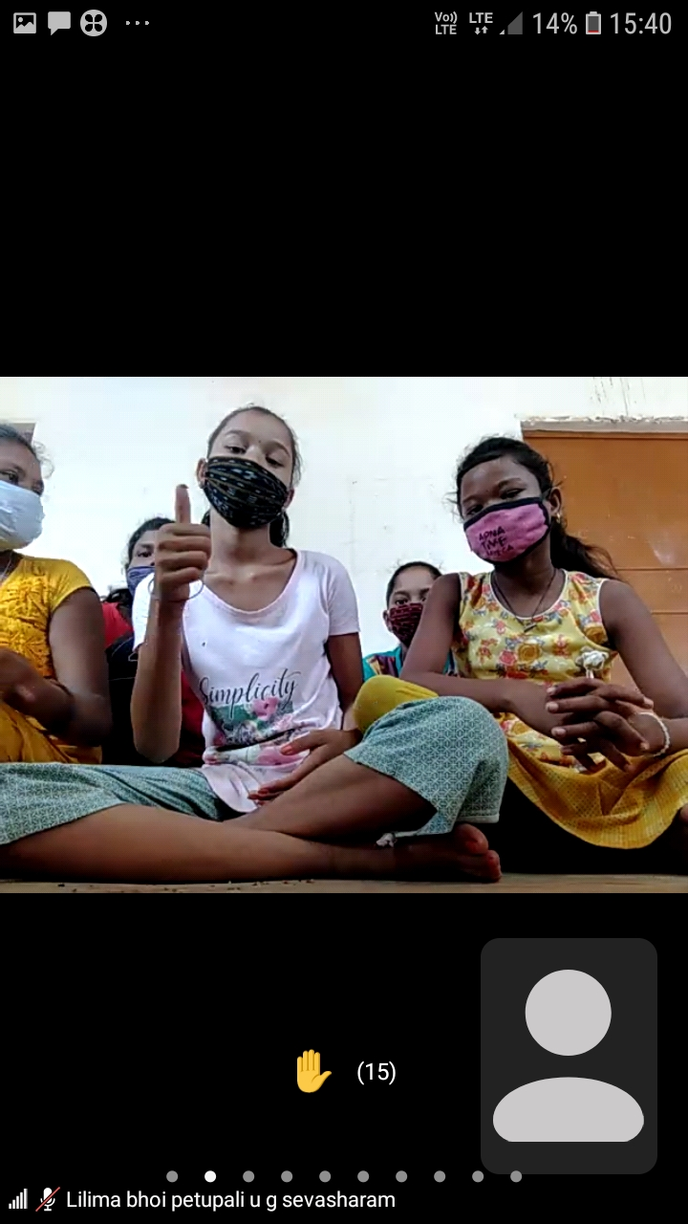
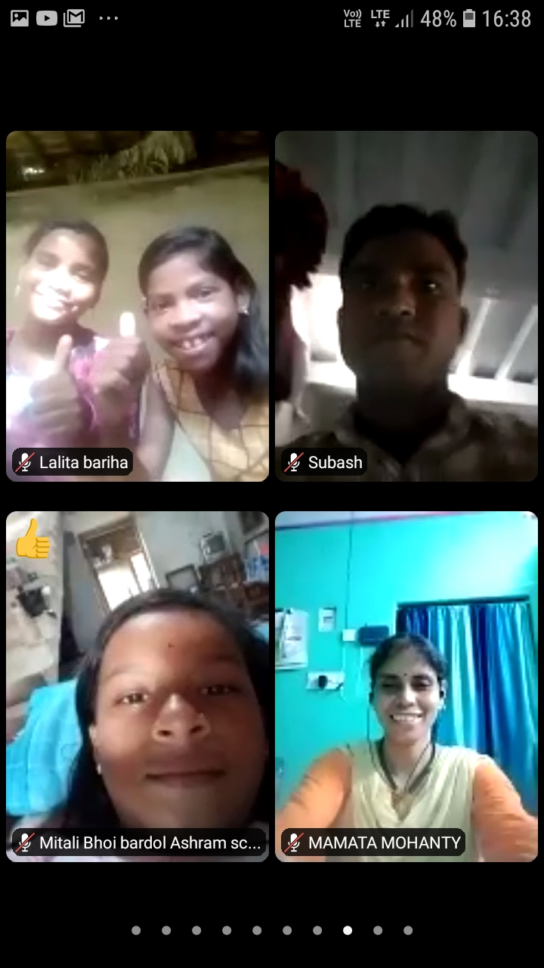
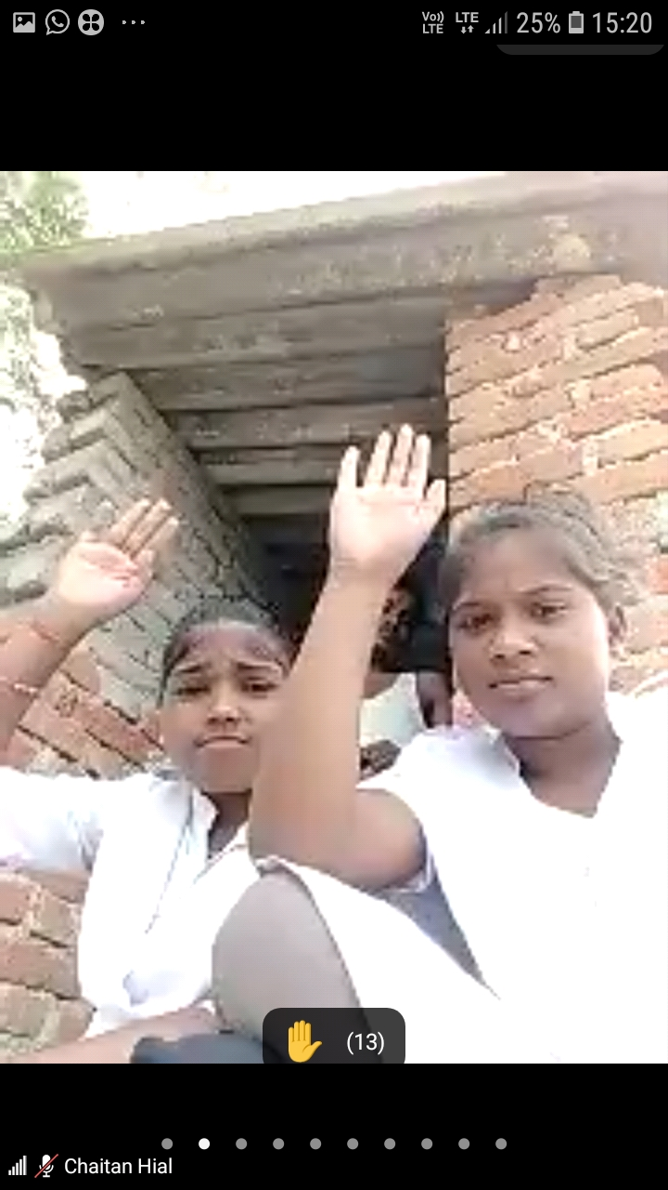
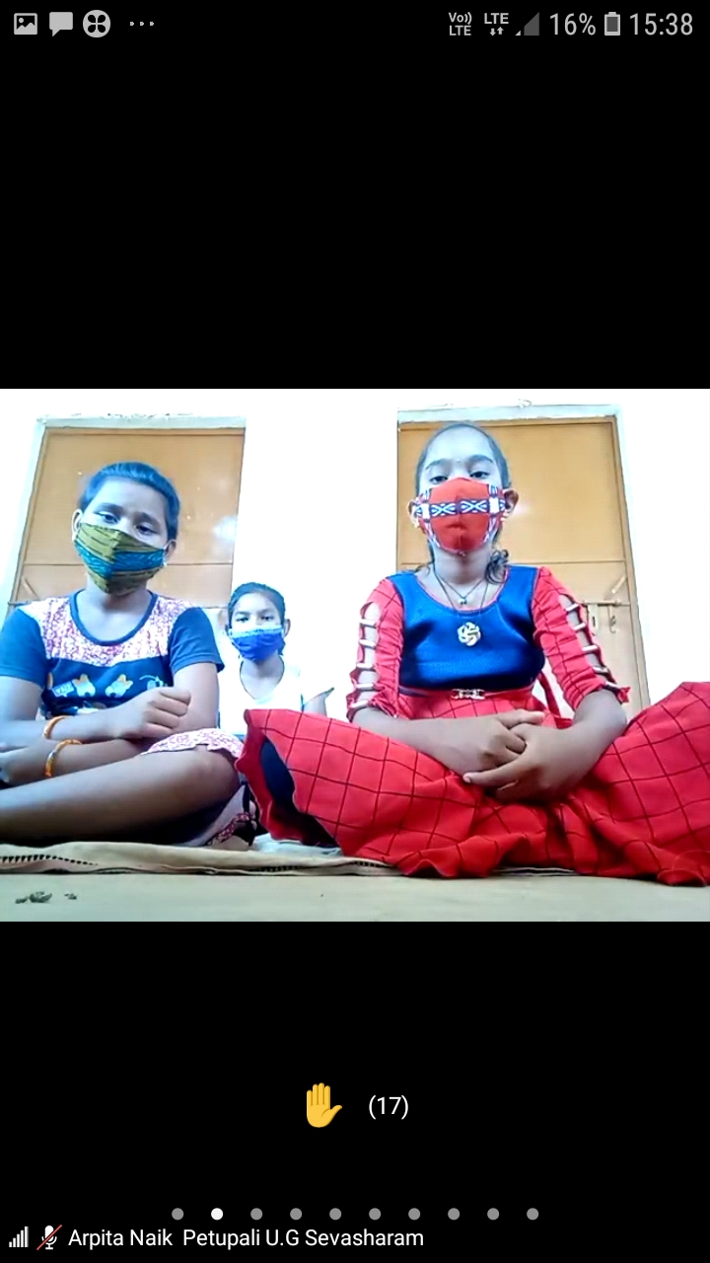
Some Glimpses on LIVE LSE Session

Slide 19
Resources from UNFPA and its Utilization

Slide 20
Mobilization of Additional Resources for Life Skills Education in Residential Schools
Activities carried out with these resources:
Training of Teachers, Matrons, ANMs and Peer Educator
Printing of IEC tools for life skills education
District level review and reorientation for HMs and other stakeholders for safety and wellbeing of students
Engagement of PTA/ SMC member on social issues early marriage, teen pregnancy, gender discrimination and promoting girl child education

Slide 21
LSE Programme beyond March 2021
Scaling up Life Skills Education intervention to all 1733 tribal residential schools for safety and wellbeing of students covering all 30 districts of the state
Support for implementation of School Health Programme (SHP) under Ayushman Bharat in 10 aspirational districts covering around 8400 schools

Slide 22
THANK YOU

